Slide 1

Spring Framework

Slide 2
Bean life-cycle management
An important part of any IoC container, Spring included, is that beans can be constructed in such a way that they receive notifications at certain points in their life cycle. This enables your beans to perform relevant processing at certain points throughout their life.
In general, two life-cycle events are particularly relevant to a bean:
post-initialization and pre-destruction.
In the context of Spring, the post-initialization event is raised as soon as Spring finishes setting all the property values on the bean and finishes any dependency checks that you configured it to perform. The predestruction event is fired just before Spring destroys the bean instance.

Slide 3
Bean life-cycle management
Spring provides three mechanisms a bean can use to hook into each of these events and perform some additional processing:
interface-based
method-based
annotation-based mechanisms

Slide 4
Bean life-cycle management
Using the interface-based mechanism, your bean implements an interface specific to the type of notification it wants to receive, and Spring notifies the bean via a callback method defined in the interface.
For the method-based mechanism, Spring allows you to specify, in your ApplicationContext configuration, the name of a method to call when the bean is initialized and the name of a method to call when the bean is destroyed.
For the annotation mechanism, you can use JSR-250 annotations to specify the method that
Spring should call after construction or before destruction.

Slide 5
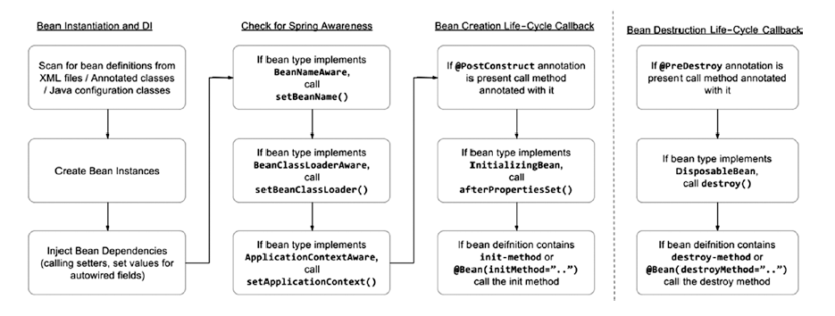
Bean life-cycle management

Slide 6
Bean life-cycle management
Executing a Method When a Bean Is Created
One way to receive the initialization callback is to designate a method on your bean as an initialization method and tell Spring to use this method as an initialization method.
Specifying a callback method is simply a case of specifying the name in the init-method attribute of a bean’s <bean> tag.
The only constraint on your initialization method is that it cannot accept any arguments. You can define any return type, although it is ignored by Spring, and you can even use a static method, but the method must accept no arguments. The benefits of this mechanism are negated when using a static initialization method, because you cannot access any of the bean’s state to validate it.

Slide 7
Bean life-cycle management
Executing a Method When a Bean Is Created
Implementing the InitializingBean Interface
The InitializingBean interface defined in Spring allows you to define inside your bean code that you want the bean to receive notification that Spring has finished configuring it. In the same way as when you are using an initialization method, this gives you the opportunity to check the bean configuration to ensure that it is valid, providing any default values along the way. The InitializingBean interface defines a single method afterPropertiesSet().

Slide 8
Bean life-cycle management
Executing a Method When a Bean Is Created
Using the JSR-250 @PostConstruct Annotation
Starting from Spring 2.5, JSR-250 annotations are also supported to specify the method
that Spring should call if the corresponding annotation relating to the bean’s life cycle exists in the class.

Slide 9
Bean life-cycle management
Executing a Method When a Bean Is Created
Declaring an Initialization Method Using @Bean
Another way to declare the initialization method for a bean is to specify the initMethod attribute for the @Bean annotation and set the initialization method name as its value.

Slide 10
Bean life-cycle management
Executing a Method When a Bean Is Created
Declaring an Initialization Method Using @Bean
Another way to declare the initialization method for a bean is to specify the initMethod attribute for the @Bean annotation and set the initialization method name as its value.

Slide 11
Bean life-cycle management
Executing a Method When a Bean Is Destroyed
To designate a method to be called when a bean is destroyed, you simply specify the name of the method in the destroy-method attribute of the bean’s <bean> tag. Spring calls it just before it destroys the instance of the bean.
Implementing the DisposableBean Interface
As with initialization callbacks, Spring provides an interface, in this case DisposableBean, that can be implemented by your beans as a mechanism for receiving destruction callbacks. The DisposableBean interface defines a single method, destroy(), which is called just before the bean is destroyed.

Slide 12
Bean life-cycle management
Executing a Method When a Bean Is Created
Using the JSR-250 @PreDestroy Annotation
The third way to define a method to be called before a bean is destroyed is to use the JSR-250 life-cycle @PreDestroy annotation, which is the inverse of the @PostConstruct annotation.

Slide 13
Bean life-cycle management
Executing a Method When a Bean Is Destroyed
Using the JSR-250 @PreDestroy Annotation
Another way to declare the destroy method for a bean is to specify the destroyMethod attribute for the @Bean annotation and set the destroy method name as its value.
Declaring a Destroy Method Using @Bean
Another way to declare the destroy method for a bean is to specify the destroyMethod attribute for the @Bean annotation and set the destroy method name as its value.

Slide 14
I18n
Internationalization with the MessageSource
One area where Spring really excels is in support for internationalization (i18n). Using the MessageSource interface, your application can access String resources, called messages, stored in a variety of languages.For each language you want to support in your application, you maintain a list of messages that are keyed to correspond to messages in other languages.
Aside from ApplicationContext, Spring provides three MessageSource implementations.
• ResourceBundleMessageSource
• ReloadableResourceBundleMessageSource
• StaticMessageSource

